Slide 1

Power Automate

Slide 2
agenda
Introduction to Power Automate
Key Features
Components
Benefits
Getting Started
Flow Types
Trigger & Action - Types
Example
Power Automate Desktop
Key Features
Components
Getting Started
Benefits
Actions – Types of actions
Example

Slide 3
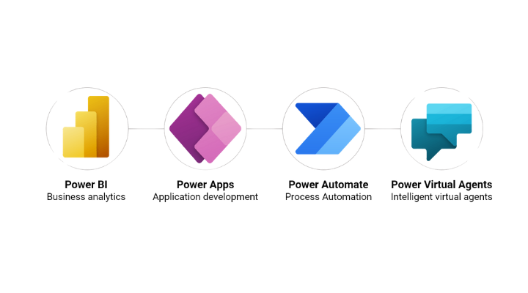
Introduction
Power Automate, previously known as Microsoft Flow, is a cloud-based service developed by Microsoft that allows users to automate workflows and integrate applications and services.
It is part of the Microsoft Power Platform, which also includes Power Apps, Power BI, Power Pages and Power Virtual Agents

Slide 4
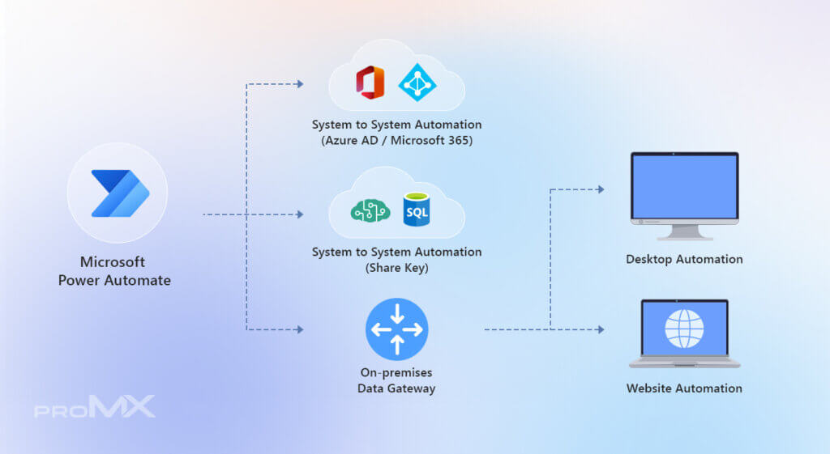
What is Power Automate?
Power Automate is designed to help users automate repetitive tasks and processes without requiring extensive coding knowledge.
It enables users to create workflows that connect various applications and services, facilitating seamless data transfer, notifications, and task automation.

Slide 5
Key Features
Automated Workflows:
  Power Automate enables users to create workflows that automate repetitive tasks.
Integration with Multiple Services:
  It supports integration with numerous applications and services, including Microsoft 365, Dynamics 365, SharePoint, and various third-party services like Dropbox, Google Drive, and Slack.
Pre-built Templates:
  Power Automate offers a wide range of pre-built templates for common workflows, which can be customized to fit specific needs. This feature helps users quickly implement automation without needing deep technical knowledge.

Slide 6
Key Features
Customizable Flow Creation:
  Users can build custom workflows using a drag-and-drop interface.
Triggers and Actions:
  Workflows in Power Automate are built around triggers (events that start the workflow) and actions (tasks performed as a result).
Business Process Flows:
  Power Automate supports more complex processes with business process flows, guiding users through a series of steps in a structured way.

Slide 7
Key Features
Robotic Process Automation (RPA):
  It includes capabilities for RPA, which allows users to automate tasks that involve interacting with legacy systems or applications that do not have APIs.
Monitoring and Management:
  Power Automate provides tools for monitoring the performance of workflows, troubleshooting issues, and managing connections.

Slide 8
Components
Flows:
  Automated Flows:
    Triggered by specific events or conditions (e.g., receiving an email, a new file in a folder).
  Instant Flows:
    Initiated manually by the user, such as through a button press in the Power Automate mobile app.
  Scheduled Flows:
    Run on a set schedule (e.g., daily, weekly) to perform tasks like data aggregation or report generation.
  Business Process Flows:
    Guide users through a set sequence of steps in a business process, ensuring consistency and compliance.

Slide 9
Components
Connectors:
  These are pre-built integrations that allow Power Automate to connect to various applications and services. There are connectors for Microsoft services (e.g., SharePoint, Outlook, Dynamics 365) as well as many third-party services (e.g., Twitter, Salesforce, Dropbox).
Triggers and Actions:
  Triggers:
    Events that start a workflow, such as receiving a new email or a change in a database record.
  Actions:
    Tasks that are performed as a result of the trigger, such as sending a notification, creating a file, or updating a database.

Slide 10
Components
Templates:
  Power Automate provides a library of pre-built templates for common workflows. These templates can be customized to fit specific needs, making it easier for users to get started with automation.
User Interface:
  The Power Automate interface is user-friendly, featuring a drag-and-drop workflow designer that allows users to create and customize workflows with minimal technical expertise.

Slide 11
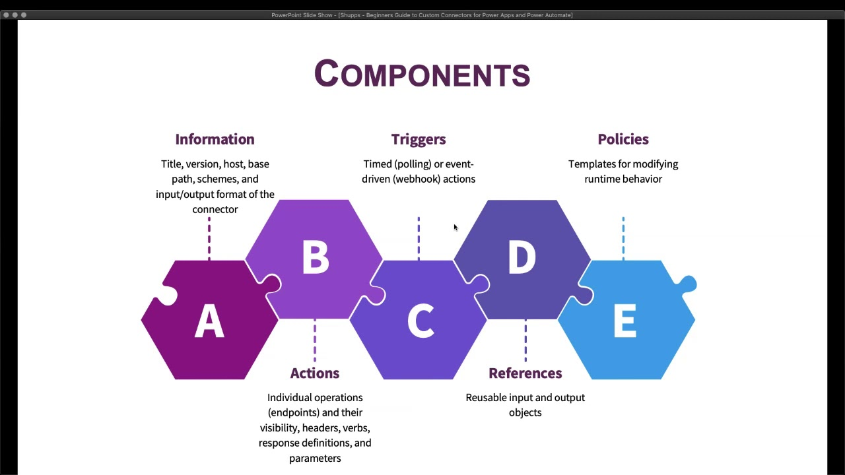
Components

Slide 12
Benefits
Increased Efficiency:
  By automating repetitive tasks, Power Automate helps save time and reduce the risk of human error, allowing employees to focus on more strategic activities.
Consistency and Standardization:
  Automation ensures that processes are executed consistently and according to predefined rules, which helps maintain quality and compliance.
Enhanced Productivity:
  Automating routine processes can lead to faster completion of tasks and improve overall productivity within an organization.

Slide 13
Benefits
Scalability:
  Power Automate can scale to handle a growing number of tasks and workflows, making it suitable for both small businesses and large enterprises.
Improved Collaboration:
  By integrating with various communication and collaboration tools, Power Automate can streamline processes that involve multiple team members or departments.

Slide 14
Getting Started with Power Automate:
Sign Up and Access:
Power Automate is accessible through the web at flow.microsoft.com, and it can also be accessed via the Power Automate mobile app.
Explore Templates:
Begin by exploring the pre-built templates to get an idea of what’s possible and to find templates that can be customized for your needs.
Create a Flow:
Use the drag-and-drop interface to create a new flow by defining triggers and actions. Test and refine the workflow as needed.
Monitor and Manage:
Utilize Power Automate’s monitoring tools to track the performance of your flows, manage connections, and troubleshoot any issues.

Slide 15
Power automate flow types
1. Automated Flows
  Purpose: These flows run automatically in response to specific triggers or events.
Examples:
  Receive a Notification: Automatically send a notification to your mobile device whenever a new item is added to a SharePoint list.
  Data Synchronization: Update a database record whenever a new email arrives in your inbox.
Use Cases:
  Monitoring changes in data.
  Automating responses to external events.
  Streamlining repetitive tasks.

Slide 16
Power automate flow types
2. Instant Flows
  Purpose: Instant flows are triggered manually by the user, often via a button or command.
Examples:
  Button Flow: Create a button in the Power Automate mobile app to quickly send a pre-written email.
  Manual Approval: Initiate an approval process for a document or request with a single click.
Use Cases:
  Performing tasks that require user initiation.
  Providing quick access to commonly used actions.
  Simplifying manual processes.

Slide 17
Power automate flow types
3. Scheduled Flows
  Purpose: These flows run at predefined intervals or on a specific schedule.
Examples:
  Daily Report: Generate and email a daily summary report every morning at 8 AM.
  Weekly Backup: Create a backup of important files to a cloud storage service every Friday at midnight.
Use Cases:
  Automating periodic tasks.
  Scheduling regular reports or notifications.
  Performing routine data backups.

Slide 18
Power automate flow types
4. Business Process Flows
  Purpose: Business process flows guide users through a series of steps to ensure consistency and compliance in a process.
Examples:
  Sales Process: Guide a sales representative through the stages of the sales pipeline, from lead capture to closing.
  Onboarding: Standardize and automate the employee onboarding process, ensuring all necessary steps are followed.
Use Cases:
  Ensuring adherence to standardized processes.
  Facilitating complex workflows involving multiple steps and approvals.
  Enhancing compliance with organizational procedures.

Slide 19
Power automate flow types
5. UI Flows (Robotic Process Automation - RPA)
  Purpose: UI flows automate interactions with user interfaces of applications, particularly those without APIs or automation-friendly interfaces.
Examples:
  Legacy Systems: Automate data entry in a legacy system that lacks modern APIs.
  Web Scraping: Extract data from a web application and process it for reporting or analysis.
Use Cases:
  Automating tasks in older or non-digital systems.
  Handling repetitive tasks that involve interacting with software interfaces.
  Performing complex data extraction and manipulation.

Slide 20
Power automate flow types
Flow Types:
  Cloud Flows: These are a broader category that includes automated, instant, and scheduled flows, designed to work with cloud-based applications and services.
  Desktop Flows: Part of Power Automate Desktop, these flows are designed for automating tasks on a local computer.
Each type of flow in Power Automate is designed to meet different automation needs, enabling users to streamline tasks, enhance productivity, and integrate various systems and services effectively.

Slide 21
Desktop Flow Overview
Desktop Flows in Power Automate, also known as Power Automate Desktop, are designed to automate tasks and processes on your local computer.
This feature is particularly useful for automating repetitive tasks that involve interactions with desktop applications or files that don’t have APIs or are difficult to integrate through cloud-based flows.

Slide 22
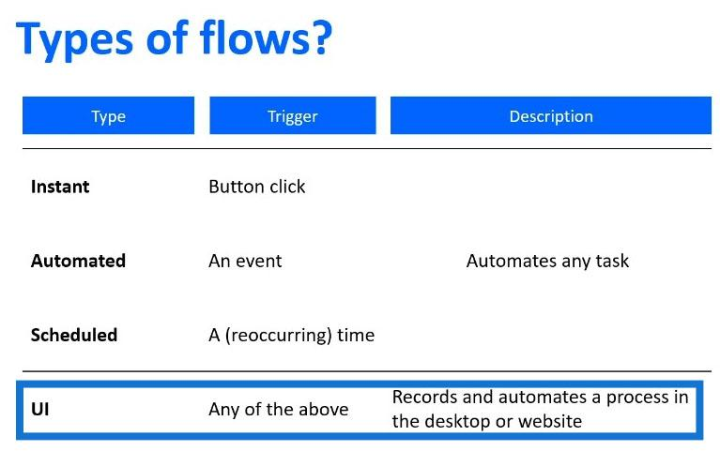
Power automate flow types

Slide 23
Triggers
In Power Automate, triggers are essential components that initiate workflows or flows.
They are the events or conditions that cause a flow to start running.
Understanding triggers is crucial for designing effective automation workflows, as they define when and why a flow should be executed.

Slide 24
Types of Triggers
Automatic Triggers:
  Event-Based Triggers: These are triggered by specific events occurring in connected services or applications.
  For example, a trigger might activate when a new email arrives in your inbox, a file is uploaded to OneDrive, or a new item is added to a SharePoint list.
    Examples:
      When a new tweet is posted with a specific hashtag.
      When a new row is added to an Excel file.

Slide 25
Types of Triggers
Manual Triggers:
  Button Triggers: These require manual initiation from the user.
  For instance, a button in the Power Automate mobile app or within a Power Apps app can start a flow.
  This is useful for processes that need user input to kick off.
    Examples:
      Pressing a button to send a pre-defined email or notification.
      Manually starting a workflow to update records.

Slide 26
Types of Triggers
Scheduled Triggers:
  Time-Based Triggers: These are designed to run flows at specific intervals or on a fixed schedule.
  Scheduled triggers are ideal for recurring tasks that need to be executed at regular times.
    Examples:
      Running a flow every day at 8 AM to generate and email a daily report.
      Scheduling a flow to backup files every Friday at midnight.

Slide 27
How Triggers Works
Define the Trigger:
Choose the type of trigger that fits your use case. For automatic and scheduled triggers, select the appropriate service and configure the conditions that will start the flow.
Configure Trigger Details:
Set up specific parameters or conditions for the trigger. For example, you might specify which email folder to monitor, which hashtag to look for in tweets, or the exact time and frequency for scheduled triggers.
Trigger Execution:
Once the specified conditions are met, the trigger activates and starts the flow. The flow then executes the defined actions based on the trigger's parameters.
Monitor and Manage:
Use Power Automate’s monitoring tools to track when triggers fire and how flows perform. Review run history and logs to ensure that triggers and flows are working as expected.

Slide 28
Examples of Common Triggers
Email Triggers:
  When a new email arrives: Start a flow whenever a new email is received in a specified folder or with certain criteria.
File Triggers:
  When a file is created or modified: Trigger a flow when a file is added to or updated in a specific location, such as a SharePoint library or OneDrive folder.

Slide 29
Examples of Common Triggers
Database Triggers:
  When a row is added or modified: Start a flow when a new record is added to or an existing record is updated in a database or a data source like SQL Server.
Social Media Triggers:
  When a new tweet is posted: Trigger a flow when a tweet with specific keywords or from specific accounts is detected.
Calendar Triggers:
  When an event is created or updated: Start a flow when a new event is added to a calendar or when an existing event is modified.

Slide 30
Actions
In Power Automate, actions are the tasks or operations that a flow performs after it is triggered.
Once a flow has been initiated by a trigger, it executes a series of actions to achieve the desired outcome.
Actions are the building blocks of workflows and can range from sending emails to updating databases, managing files, or interacting with various applications and services.

Slide 31
Types of Actions
Data Operations:
  Create, Read, Update, Delete (CRUD): Actions for managing data in databases, SharePoint lists, or other data sources.
    Examples:
      Create a new row in an Excel table.
      Update a record in a SQL database.
Communication:
  Email, Notifications, Messaging: Actions for sending emails, notifications, or messages through various channels.
    Examples:
      Send an email with specific content.
      Post a message to a Microsoft Teams channel.

Slide 32
Types of Actions
Approval and Task Management:
  Approval Requests: Actions for creating and managing approval requests and tasks.
    Examples:
      Start an approval process for a document or request.
      Create a task in Microsoft To Do or Planner.
Integration with External Systems:
  API Calls: Actions for making HTTP requests to external services or APIs.
    Examples:
      Call a REST API to update an external system.
      Post data to a web service endpoint.

Slide 33
Types of Actions
Data Manipulation:
  Transformations and Calculations: Actions for processing and transforming data.
    Examples:
      Convert data from one format to another.
      Perform calculations or data aggregations.
Control Actions:
  Conditions, Loops, and Termination: Actions for controlling the flow of the workflow based on conditions and logic.
    Examples:
      Use a condition to determine the next steps based on data values.
      Loop through a list of items and perform actions on each one.

Slide 34
Types of Actions
File and Document Management:
  File Operations: Actions for managing files, such as uploading, downloading, or modifying documents.
    Examples:
      Save an attachment from an email to a SharePoint document library.
      Copy a file from one folder to another.

Slide 35
How to Use Actions in a Flow
Add Actions:
  Once you have defined your trigger, add actions to your flow by selecting them from the available connectors and configuring their parameters.
Configure Parameters:
  Set the parameters for each action based on the data you want to process. For instance, if you’re sending an email, specify the recipient, subject, and body content.
Use Dynamic Content:
  Incorporate dynamic content from previous steps to personalize and customize actions. This allows actions to adapt based on the data processed by the flow.

Slide 36
How to Use Actions in a Flow
Apply Logic:
  Use conditional logic and loops to create more sophisticated workflows. Actions within these constructs can be executed based on specific conditions or repeated for each item in a collection.
Test and Refine:
  Test your flow to ensure that actions are executed as expected. Refine configurations and error handling to improve the reliability and performance of the flow.

Slide 37
Examples of Common Actions
Send Email:
  Action: Send an email with specified recipients, subject, and body text.
  Use Case: Notify a team when a new item is added to a project management tool.
Create Item:
  Action: Create a new item in a SharePoint list or database.
  Use Case: Log new customer inquiries into a CRM system.
Update Record:
  Action: Update an existing record in a data source.
  Use Case: Update a status field in a project management application when a task is completed.
Post Message:
  Action: Post a message to a chat or team channel.
  Use Case: Announce important updates to a team in Microsoft Teams.

Slide 38
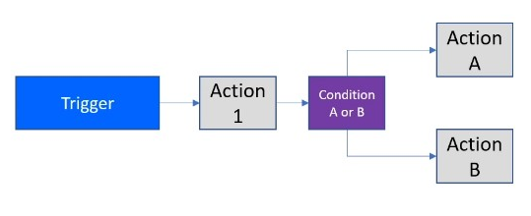
Trigger And actions

Slide 39
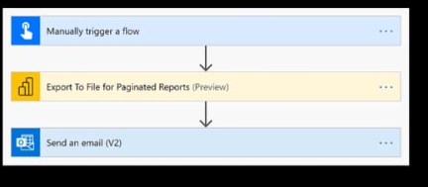
Example: reporting the email from power bi report builder
Paginated Report –
Email a report

Slide 40
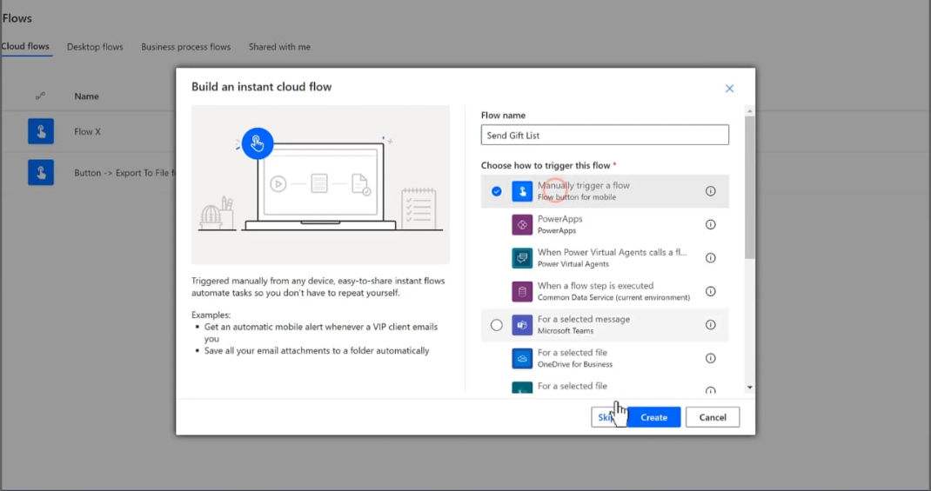
Step 1:
Create a manual trigger flow

Slide 41
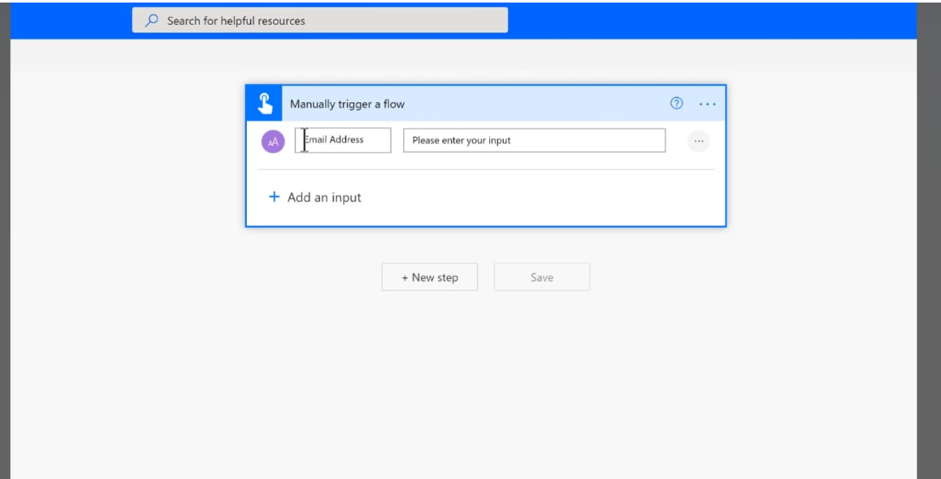
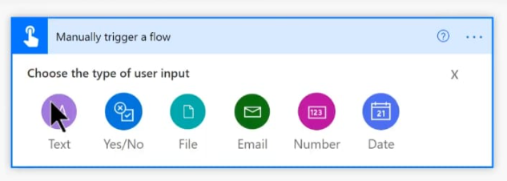
Step 2:
Choose Text and give the input as Email address

Slide 42
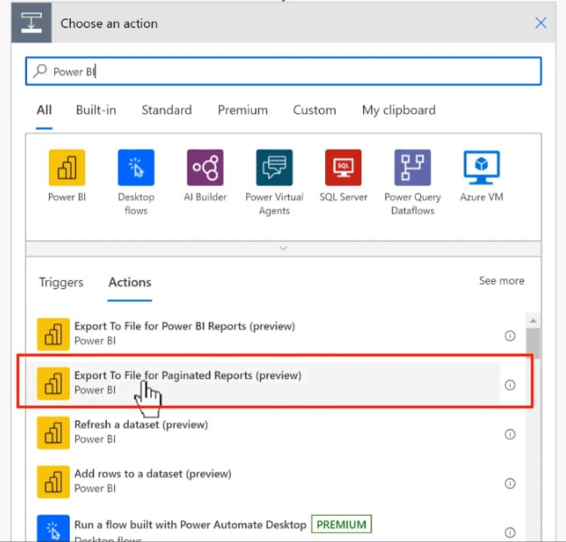
Step 3:
Choose an action ( Export to file for Paginated Reports)

Slide 43
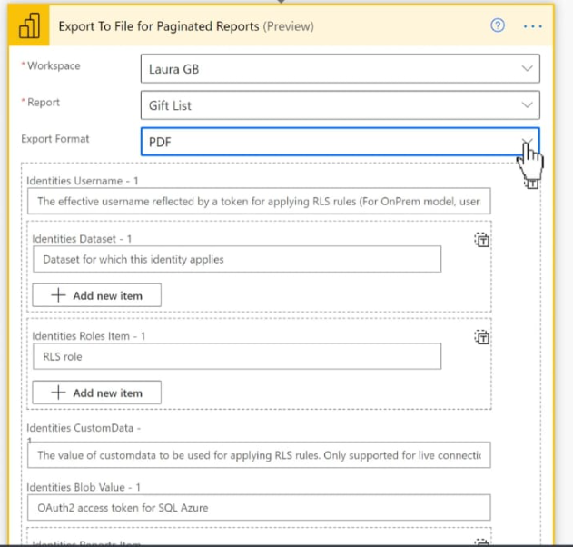
Step 4: fill up the details in the parameter

Slide 44
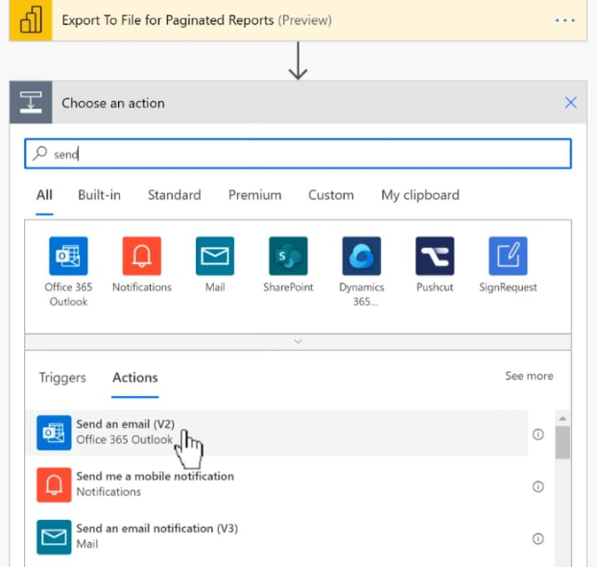
Step 5:
Again choose an action (send an email)

Slide 45
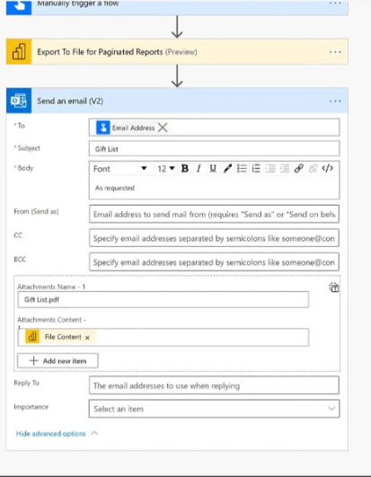
Step 6:
Fill up the action parameter

Slide 46
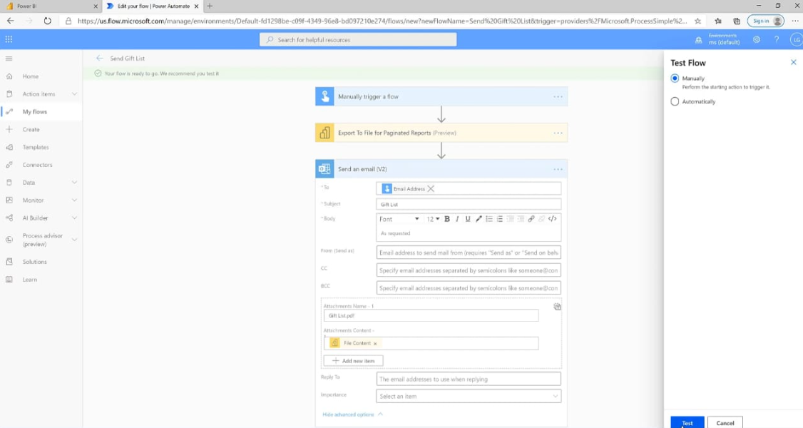
Step 7:
Save the flow and test it

Slide 47
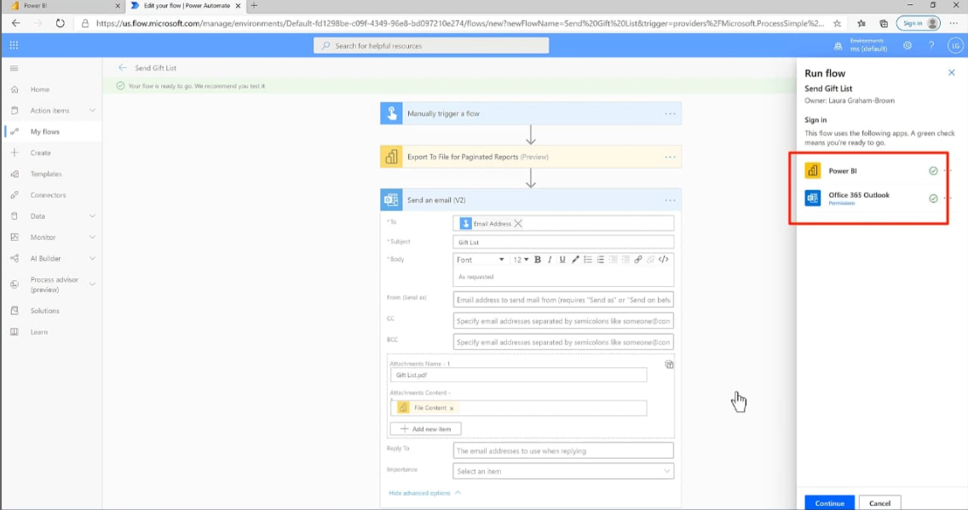
Step 8:
Check the connectors

Slide 48
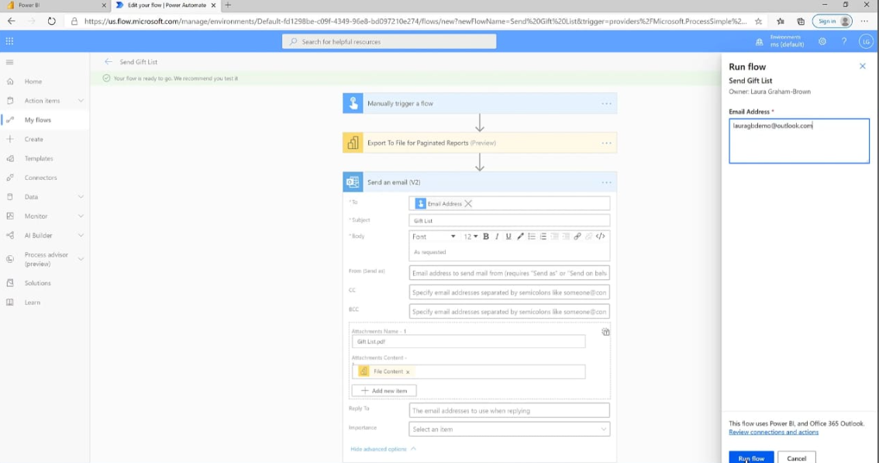
Step 9:
Run the flow by providing the email address in the input field

Slide 49
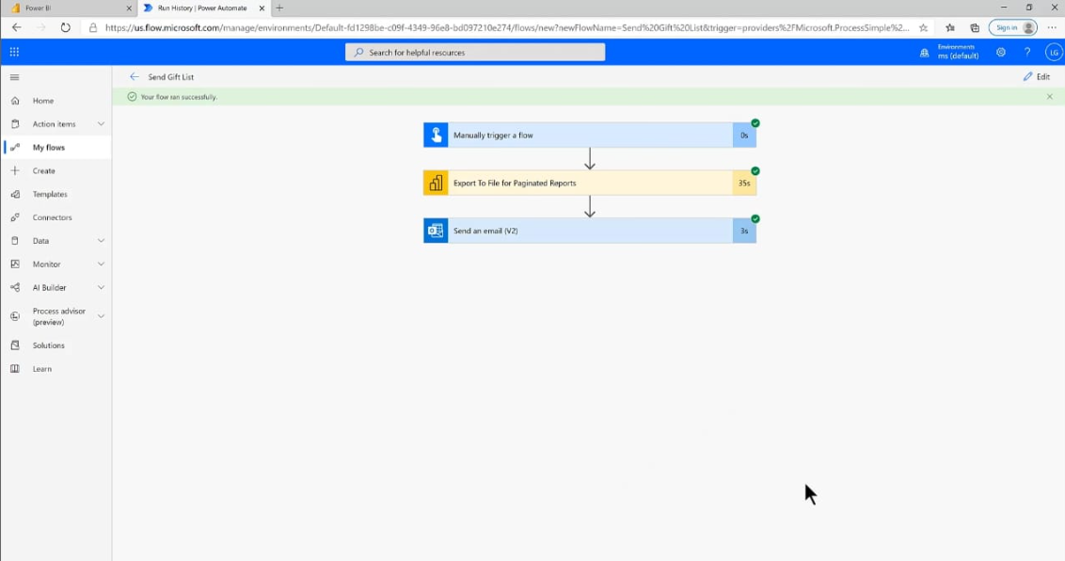
Step 10:
After execution of the flow

Slide 50
Power automate Desktop

Slide 51
What is Power Automate Desktop?
Power Automate Desktop is part of the Microsoft Power Automate suite and allows users to automate desktop-based processes and tasks.
It supports creating and running automated workflows, known as "flows," to streamline various activities on a Windows machine.

Slide 52
Power automate vs power automate desktop
Power Automate
Power Automate Desktop
Named “power automate” at “ignite 2019” RPA
A Cloud-based software
Automated workflows are called flows.
450+Connectors
AI features.
A new desktop-based RPA
A Desktop based software
Automate ant desktop or web-based application
370 + Actions
Web Recorder and Desktop Recorder

Slide 53
similarities
RPA
Automate the task with flows
Low code or No code
Microsoft Products

Slide 54
Key Features
Drag-and-Drop Interface:
  User-Friendly Design: Offers a visual interface where users can drag and drop actions to build workflows without needing extensive coding knowledge.
Wide Range of Actions:
  File Operations: Automate file creation, deletion, renaming, and manipulation.
  Data Handling: Read from and write to databases, Excel spreadsheets, and other data sources.
  UI Automation: Interact with software applications by mimicking user actions like clicking buttons, entering text, and navigating through applications.
  Web Automation: Automate web interactions such as data scraping, form submission, and web navigation.

Slide 55
Key Features
Integration with Other Tools:
  Microsoft Ecosystem: Seamlessly integrates with other Microsoft services, including SharePoint, Outlook, and Dynamics 365.
  Custom APIs: Connect with third-party APIs and services to extend functionality.
Conditional Logic:
  Decision Making: Implement if-then conditions, loops, and other logical constructs to handle complex workflows and decision-making.

Slide 56
Key Features
Error Handling and Logging:
  Robust Monitoring: Built-in features to manage errors and exceptions, providing detailed logs and notifications for better monitoring and troubleshooting.
Data Extraction and Manipulation:
  Text and Data Extraction: Extract and manipulate data from various sources, including text files, web pages, and more.
Automation Recording:
  Record Actions: Use the recorder to capture and replicate user interactions with applications, converting these actions into automated workflows.

Slide 57
Components
Actions:
  Basic Actions
  UI Automation Actions
  Web Automation Actions
  File Actions
  Excel Actions
  Database Actions
Variables:
  Global Variables: Accessible throughout the entire flow.
  Local Variables: Accessible only within the specific scope where they are defined.

Slide 58
Components
Flows:
  Main Flow: The central flow that orchestrates the sequence of actions.
  Subflows: Smaller flows that can be invoked from the main flow to modularize the automation.
Conditions and Branching:
  If Conditions: Allow you to execute different actions based on whether certain conditions are met.
  Switch Cases: Handle multiple conditions by branching into different cases.
Loops:
  For Each: Iterate over a collection of items and perform actions for each item.
  While: Execute actions repeatedly as long as a specified condition is true.

Slide 59
Components
Error Handling:
  Try-Catch: Define actions to take when an error occurs in the flow.
  Error Handling Actions: Specific actions to manage errors, such as logging or retrying operations.
Data Operations:
  Data Parsing: Extract and manipulate data from various sources, such as JSON or XML.
  String Operations: Perform operations on text, like substring extraction or string replacement.
User Input:
  Forms: Collect input from users through customizable forms.
  Dialogs: Display messages or prompts to users.

Slide 60
Components
Connectors:
  Built-In Connectors: Integrate with various services and applications, such as email, SharePoint, and social media.
  Custom Connectors: Create connections to APIs or services not covered by built-in connectors.
Debugging and Monitoring:
  Debugging Tools: Step through flows, set breakpoints, and inspect variable values to troubleshoot issues.
  Logs: Track the execution history and status of flows for monitoring and auditing purposes.

Slide 61
Common Use Cases
Business Process Automation:
  Invoice Processing: Automate the extraction of data from invoices and update records in ERP systems.
  Report Generation: Automatically generate and distribute reports based on predefined schedules or triggers.
Data Entry and Management:
  Excel Automation: Automate data entry, updates, and report generation in Excel.
  Database Operations: Perform bulk data entry, updates, and queries in SQL databases.

Slide 62
Common Use Cases
Customer Support:
  Ticket Management: Automate ticket creation, updates, and notifications in customer support systems.
  Email Handling: Process and respond to emails based on specific rules or triggers.
Routine Task Automation:
  File Management: Automate tasks like organizing files, archiving documents, and synchronizing directories.
  System Maintenance: Schedule and automate system backups, updates, and other maintenance tasks.

Slide 63
Getting Started
Installation:
  Download: Available for download from the Microsoft website or via the Microsoft Store.
  Setup: Follow the installation prompts to set up Power Automate Desktop on your Windows machine.
Creating a Flow:
  New Flow: Start by creating a new flow using the drag-and-drop interface.
  Add Actions: Use pre-built actions or custom scripts to define the steps of your workflow.
  Test and Deploy: Test your flow thoroughly before deploying it for regular use.
Integration and Expansion:
  Explore Connectors: Utilize connectors to integrate with other Microsoft and third-party services.
  Extend Capabilities: Leverage Power Automate’s broader ecosystem to enhance automation capabilities.

Slide 64
Getting Started with Desktop Flows
Install Power Automate Desktop:
Download and install the Power Automate Desktop application from the Microsoft website.
Create a Desktop Flow:
Open the Power Automate Desktop app and use the visual designer to create a new desktop flow. Add actions to interact with your desktop applications and files.
Test and Debug:
Test your desktop flow to ensure it works as expected. Use debugging tools to troubleshoot any issues.
Schedule and Monitor:
Schedule your desktop flows to run automatically or trigger them manually as needed. Monitor their execution and review logs to ensure they are performing correctly.
Integrate with Cloud Flows:
Connect your desktop flows with cloud flows to create end-to-end automation solutions that span both local and cloud environments.

Slide 65
Benefits
Increased Efficiency: Reduces manual effort and time spent on repetitive tasks.
Consistency: Ensures processes are carried out consistently and accurately.
Scalability: Scales automation solutions across different processes and departments.
Cost Savings: Reduces operational costs by minimizing manual intervention and errors.

Slide 66
actions
In Power Automate Desktop, actions are the building blocks of automated workflows.
They perform specific tasks or operations within your flow.
By using actions, you can automate a wide range of tasks, increasing efficiency and reducing manual effort in your daily workflows.

Slide 67
types of actions
File and Folder Actions
  Create File: Create new files with specified content and format.
  Delete File: Remove files from your system.
  Rename File: Change the name of a file.
  Move File: Move files to a different directory.
  Copy File: Duplicate files to a specified location.
  Create Folder: Create new directories or folders.
  Delete Folder: Remove folders and their contents.

Slide 68
types of actions
Excel Actions
  Launch Excel: Open Excel to interact with workbooks.
  Read from Excel: Extract data from cells, ranges, or sheets.
  Write to Excel: Input data into specified cells, ranges, or sheets.
  Save Excel: Save changes to a workbook.
  Close Excel: Close an Excel workbook or the application.

Slide 69
types of actions
Web Actions
  Launch Browser: Open a web browser and navigate to a specific URL.
  Navigate to URL: Direct the browser to a new web page.
  Click Element: Simulate a mouse click on a web element.
  Extract Data: Retrieve text or attributes from web elements.
  Fill Form: Enter data into web forms and submit them.
  Get Web Page Content: Extract the full HTML content of a web page.

Slide 70
types of actions
UI Automation Actions
  Click Button: Simulate a mouse click on a button or control.
  Set Text: Enter text into input fields or text boxes.
  Get Text: Retrieve text from a UI element.
  Select Item: Choose an item from a dropdown list or combo box.
  Send Keys: Simulate keystrokes to interact with applications.

Slide 71
types of actions
Data Actions
  Get Data: Extract data from various sources like databases or APIs.
  Set Data: Update or insert data into a database or other data source.
  Parse Data: Convert data from one format to another (e.g., JSON to XML).
  Format Data: Apply formatting to data (e.g., date formats, number formats).

Slide 72
types of actions
System Actions
  Launch Application: Open any application installed on your machine.
  Close Application: Terminate running applications.
  Run DOS Command: Execute command-line operations.
  Get System Information: Retrieve details about your system or environment.

Slide 73
types of actions
Control Actions
  If Condition: Perform actions based on conditional logic (if-then-else statements).
  Loop: Execute a set of actions multiple times based on a condition (e.g., for-each loops).
  Delay: Pause execution for a specified amount of time.
  Terminate Flow: End the flow execution based on certain conditions.

Slide 74
types of actions
Variables and Data Manipulation
  Set Variable: Define and assign values to variables.
  Get Variable: Retrieve the value of a variable.
  Modify Variable: Change the value of an existing variable.
  Convert Data Type: Change data types for variables (e.g., string to integer).

Slide 75
types of actions
Application-Specific Actions
  PowerPoint Actions: Create and manipulate PowerPoint presentations, such as adding slides or setting slide content.
  PDF Actions: Extract data from or manipulate PDF documents.

Slide 76
types of actions
Basic Actions
  Perform fundamental tasks like setting text, variables, loops, control flow, pausing & delaying, file operations and conditions.
  It serve as the core components for building and controlling your automation processes.

Slide 77
Creating a Flow with Actions
Start a New Flow:
Open Power Automate Desktop and create a new flow.
Drag and Drop Actions:
Use the actions pane to drag and drop desired actions onto the workflow canvas.
Configure Actions: Customize each action with parameters like file paths, data sources, and conditions.
Test the Flow:
Run the flow to ensure all actions execute as expected and refine as needed.

Slide 78
Example: Automating Report Generation
Actions in Excel Automation using Power Automate Desktop :
  Launch Excel and open a report template.
  Read from Excel Work Sheet
  Write data to the Excel template.
  Save and close the Excel file.
  Send the report via email.

Slide 79
Example: web Scraping
Actions in Web Scraping using Power Automate Desktop :
  Launch a web browser and navigate to a webpage.
  Extract data from specific elements on the page.
  Save the extracted data to a file or database.

Slide 80
THANKYOU

